Slide 1
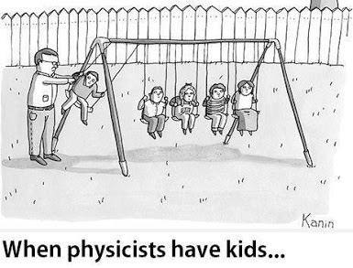
PHYS 1050 Tutorial 2
Yutong Zhao
Department of Physics and Astronomy
Oct 8th, 2019

Slide 2
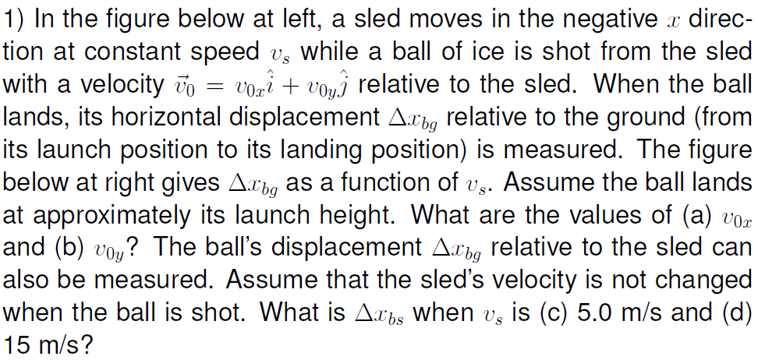
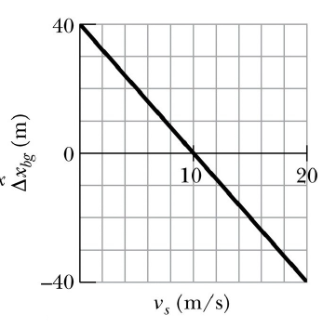
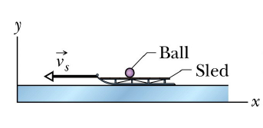
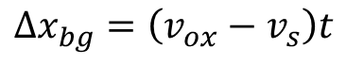
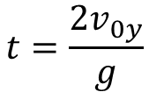
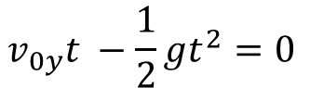
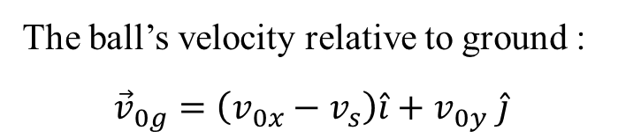
Time it take to retouch ground
$$v_{0y}t −\frac{1}{2}gt^{2}=0$$
$$t=\frac{{2v}_{0y}}{g}$$
The ball’s velocity relative to ground :
$${\vec{v}}_{0g}=\left(v_{0x}−v_{s}\right)\hat{i}+v_{0y} \hat{j}$$
Displacement relative to ground
$$Δx_{bg}=\left(v_{ox}−v_{s}\right)t$$

Slide 3
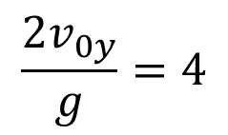
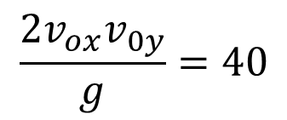
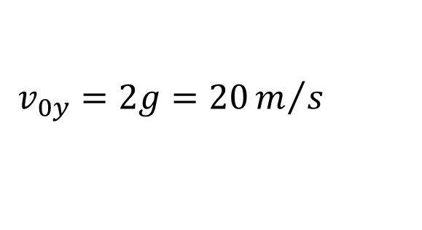
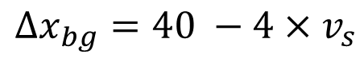
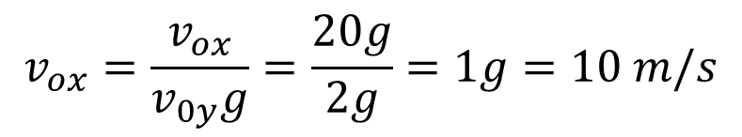
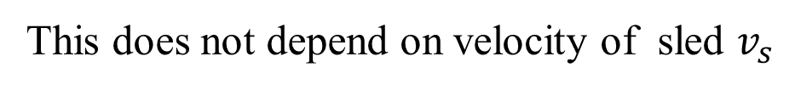
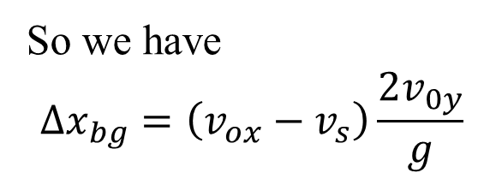
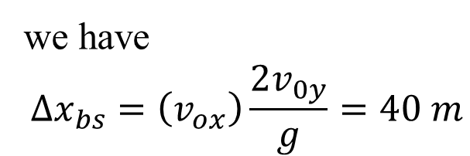
(a,b)
So we have
$$Δx_{bg}=\left(v_{ox}−v_{s}\right)\frac{{2v}_{0y}}{g}$$
$$\frac{{2v}_{0y}}{g}=4$$
$$Δx_{bg}=40 −4×v_{s}$$
$$v_{0y}=2g=20m/s$$
$$\frac{{2v_{ox}v}_{0y}}{g}=40$$
$$v_{ox}=\frac{v_{ox}}{v_{0y}g}=\frac{20g}{2g}=1g=10 m/s$$
(c,d)
we have
$$Δx_{bs}=\left(v_{ox}\right)\frac{{2v}_{0y}}{g}=40 m$$
This does not depend on velocity of sled $v_{s}$

Slide 4
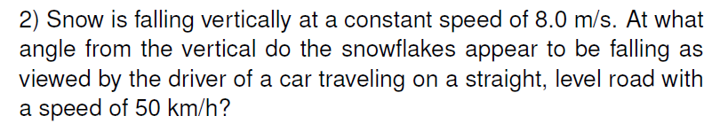
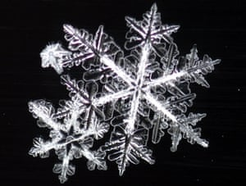
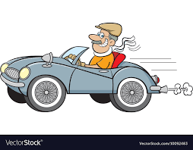
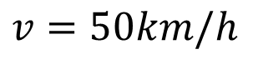
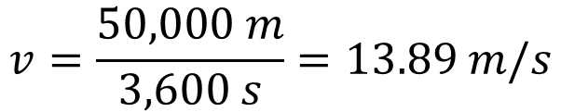
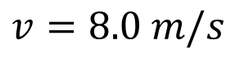
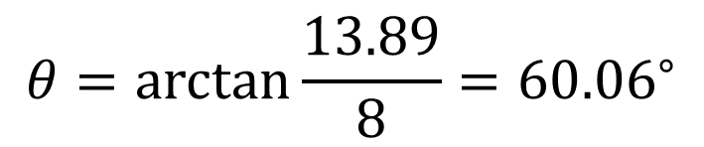
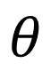
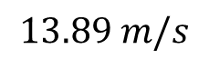
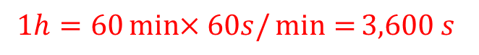
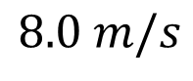
$$1h=60\min{×60s/\min{=}}3,600 s$$
$$v=\frac{50,000 m}{3,600 s}=13.89 m/s$$
$$θ$$
$$8.0 m/s$$
$$v=50km/h$$
$$v=8.0 m/s$$
$$13.89 m/s$$
$$θ=\arctan{\frac{13.89}{8}}={60.06}^{∘}$$

Slide 5
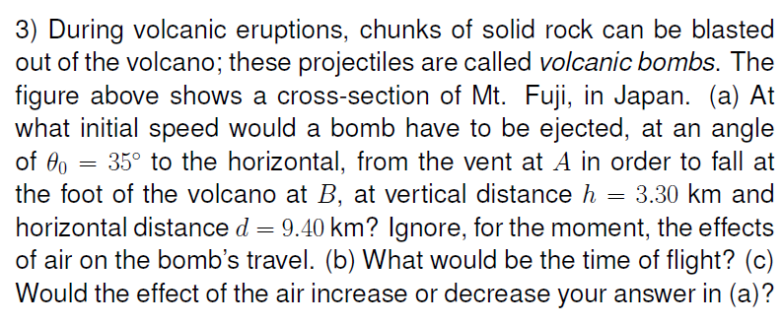
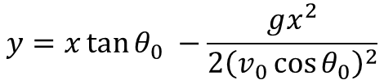
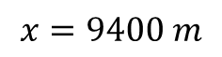
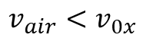
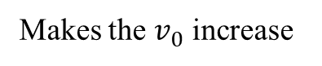
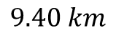
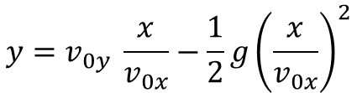
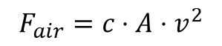
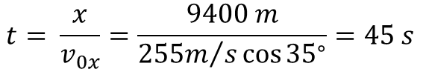
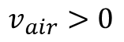
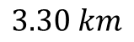
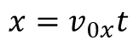
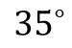
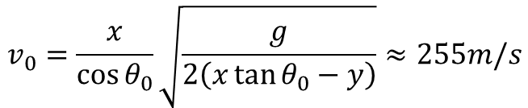
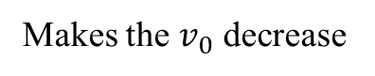
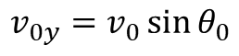
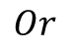
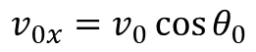
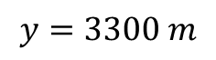
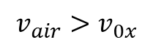
$${35}^{∘}$$
$$3.30 km$$
$$9.40 km$$
(a)
$$x=v_{0x}t$$
(c)
$$F_{air}=c⋅A⋅v^{2}$$
$$v_{0x}=v_{0}\cos{θ_{0}}$$
$$y=v_{0y} \frac{x}{v_{0x}}−\frac{1}{2}g{\left(\frac{x}{v_{0x}}\right)}^{2}$$
$$v_{0y}=v_{0}\sin{θ_{0}}$$
$$v_{air}<v_{0x}$$
$$v_{air}>0$$
$$y=x\tan{θ_{0}} −\frac{gx^{2}}{2{\left(v_{0}\cos{θ_{0}}\right)}^{2}}$$
$$x=9400 m$$
$$Or$$
$$y=3300 m$$
Makes the $v_{0}$ increase
$$v_{0}=\frac{x}{\cos{θ_{0}}}\sqrt{\frac{g}{2\left(x\tan{θ_{0}−y}\right)}}≈255m/s$$
$$v_{air}>v_{0x}$$
(b)
$$t= \frac{x}{v_{0x}}=\frac{9400 m}{{255m}/s\cos{{35}^{∘}}}=45 s$$
Makes the $v_{0}$ decrease

Slide 6
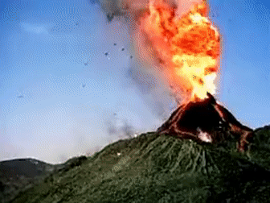
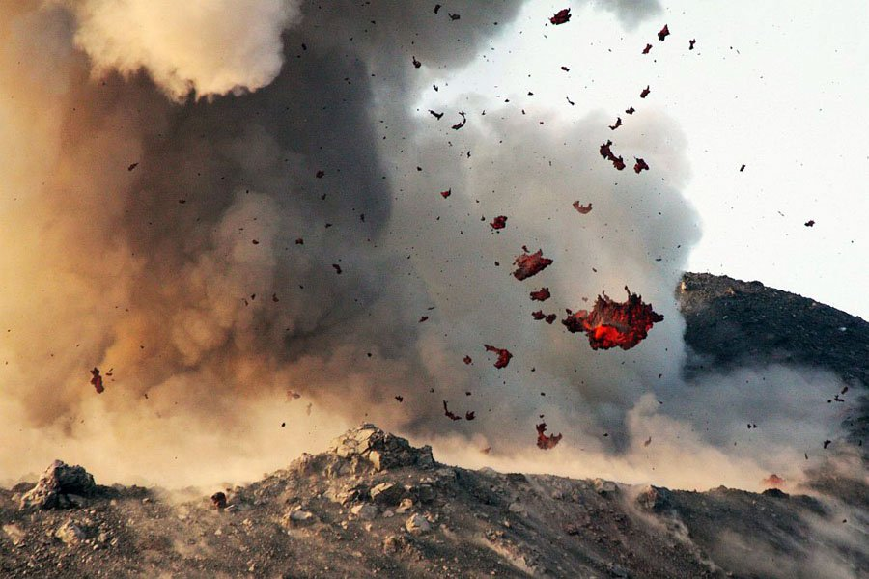

Slide 7
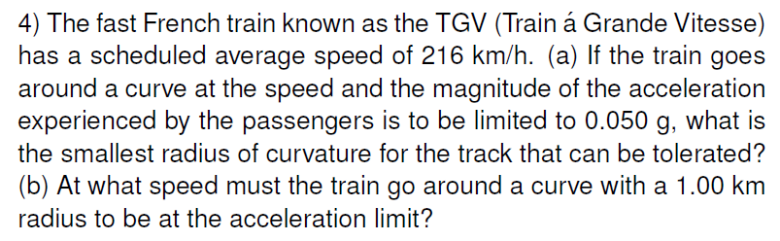







(a)
$$v=\frac{216 000 m}{3600 s}=60 m/s$$
$$a=\frac{v^{2}}{r}=0.05 g$$
$$r=\frac{v^{2}}{0.05 g}=\frac{{\left({60m}/s\right)}^{2}}{0.05×10 m/s^{2}}=7200 m$$
(b)
$$v=\sqrt{ar }=\sqrt{0.05g 1000m}≈{22.36m}/{s=} 80.5 km/h$$

Slide 8





= 430 km/h
= 400 km/h
Bullet Trains

Slide 9



Slide 10












$$θ$$
$$v_{1}=80 km/h$$
$$θ′$$
$$v_{1}=23.61 m/s$$
$$v_{2}=650 m/s$$
$$v_{2}×80\%\cos{θ}=v_{1}$$
$$θ=\cos^{−1}{\frac{v_{1}}{0.8×v_{2}}=\cos^{−1}{\frac{23.61}{0.8×650}}={87}^{∘} }$$
$$θ^{′}={180}^{∘} −{87}^{∘}={93}^{∘}$$

Slide 11












$$30kg$$
$$40kg$$
$$T$$
$$10kg$$
(a)
C
$$\left(m_{B}+m_{C}\right)g=\left(m_{A}+m_{B}+m_{C}\right)a$$
$$a=\frac{\left(m_{B}+m_{C}\right)}{\left(m_{A}+m_{B}+m_{C}\right)}g=\frac{5}{8}g$$
$$m_{C}g$$
$$T −m_{C}g=−m_{C}a$$
$$T =m_{C}g−m_{C}a=\frac{3}{8}m_{C}g=37.5 N$$
(b)
$$x=\frac{1}{2}at^{2}=\frac{5}{16}×10×{\left(0.25\right)}^{2}=0.1953 m$$

Slide 12








$$?$$
$$44 N$$
(a)
$$22 N$$
$$μ_{s}\left(m_{A}+m_{C}\right)g=m_{B}g$$
$$m_{c}g=\frac{m_{B}g −μ_{s}m_{A}}{μ_{s}}=\frac{22N −0.2×44N}{0.2 }=66N$$
(b)
$$\left(m_{A}+m_{B}\right)a=m_{B}g −μ_{s}m_{A}g$$
$$a=\frac{m_{B}g −μ_{s}m_{A}g}{m_{A}+m_{B}}=\frac{22N−0.15×44N}{22N+44N}=0.233g=2.3 m/s$$

Slide 13


